Slide 1
FLS Unit 12
Johnny Vogt

Slide 2
QQQ
B
D
4

Slide 3
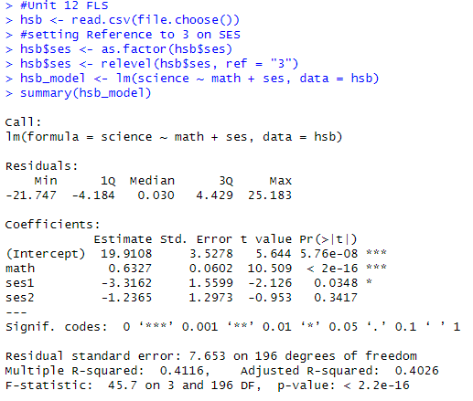
HSB2
Regression Model: Science_{i} = β₀ + β₁(Mathi) + β₂(SES1_{i}) +β₃(SES2i) + Ɛ_{i} Science_{i} = 15.21 + 0.63(Math_{i}) - 3.316(SES1_{i}) - 1.24(SES2_{i}) + Ɛ_{i}
Yes, we can quantify this equation For SES(1), the score will be 3.32 points lower than a SES score of 3 for every increase in the math score
For SES(2), the score will be 1.24 points lower than a SES score of 3 for every increase in the math score

Slide 4
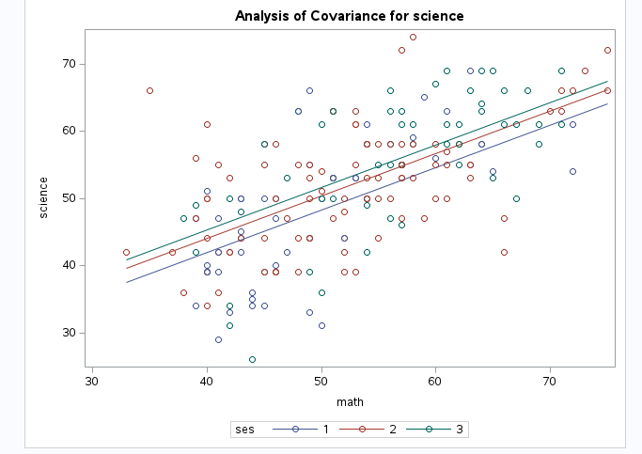
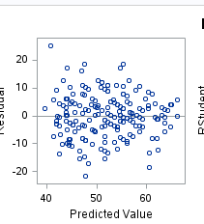
HSB Q1 Assumptions
Linearity: The regression lines follow a very straight line
Homeoscedasticity and Normality: As far as we can tell from a visual look, there seems to be equal variances and fairly n normal distribution for every subset of X
Independece: every point represents a individual student and their score. As far as we can tell, they are independent, until further information is given.
Residual Normality: the residual seem to have a random scatter around regression. No pattern to ascertain.

Slide 5
HSB2 Question
Oh.. I think i already did it in sas and r
proc glm data=WORK.HSB plots=all;
class SES (ref='3');
model science = math SES;
Run; hsb$ses <- as.factor(hsb$ses)
hsb$ses <- relevel(hsb$ses, ref = "3")
hsb_model <- lm(science ~ math + ses, data = hsb)
summary(hsb_model)
And no, there no evidence that suggests the slopes are different. They rise fall at the same rate between each subset of X, but the value changes due to the effect of the SES Value, either raising or lowering the value on the y scale depending on the score

Slide 6
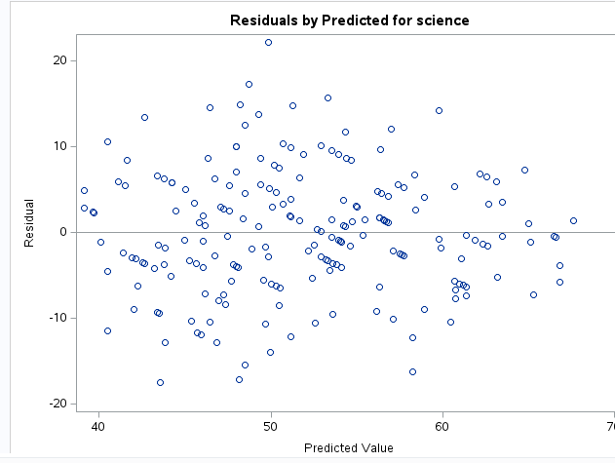
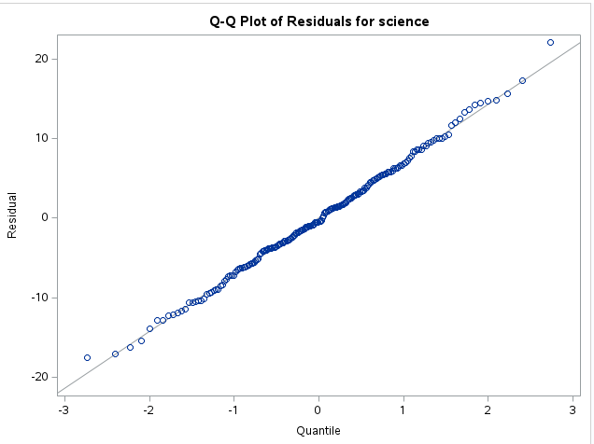
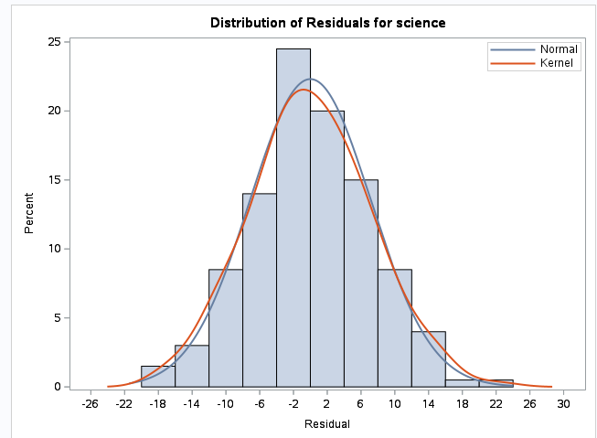
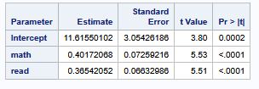
Question 3
As for assumptions, the data seems very normal, each point is independent, the residual plot seems to be scattered randomly, although, there might be a difference in variance on the right side of the plot. We will proceed cautiously.
Model Equation: Science_{i} = 11.62 + 0.401(Math_{i}) + 0.3654(Reading_{i}) + Ɛ_{i}
After fitting a model for predicting the science score by holding the reading score constant. For every on point increase in the math score has an associated .4 increase to the Science score.

Slide 7
Question 3
proc glm data=WORK.HSB;
model science = math read;
run;
ods graphics on;
proc glm data=WORK.HSB plots=diagnostics(unpack);
model science = math read;
run;

Slide 8
Takeaways
Feeling a bit burned out, but it’s probably from work. Been working late and not getting enough time to work on this.
I realized tonight that I don’t know how to read the cook’s D plot, thankfully I dont think outliers played a role in the data
Please dont make us log this (no more logs, LOL). I dont know if my brain can handle it.
I dont think I fully grasp, how by adding reading to the model, it holds it constant throughout and helps us determine the relationship between math and science. Is that also true for the “Reading” and Science score in the same model?

